Slide 1
Chapter 5: Adjust and Troubleshoot Single-Area OSPF
Scaling Networks
Notes:
Cisco Networking Academy program
Scaling Networks
Chapter 5: Adjust and Troubleshoot Single-Area OSPF

Slide 2
Chapter 5
5.0 Introduction
5.1 Advanced Single-Area OSPF Implementations
5.2 Troubleshooting Single-Area OSPF Implementations
5.3 Summary
Notes:
Chapter 5

Slide 3
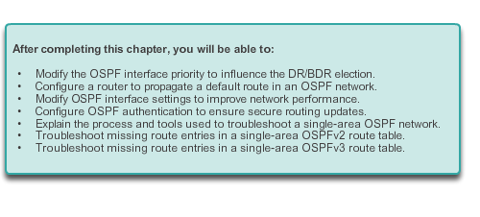
Chapter 5: Objectives

Slide 4
5.1 Advanced Single-Area OSPF Configurations
Notes:
5.1 Advanced Single-Area OSPF Configurations

Slide 5
Routing in the Distribution and Core Layers Routing versus Switching
Switches, link aggregation, LAN redundancy and wireless LANs are all technologies that provide or enhance user access to network resources.
Scalable networks also require optimal reachability between sites. Remote network reachability is provided by routers and Layer 3 switches which operate in the distribution and core layers.
Routers and Layer 3 switches learn about remote networks in one of two ways:
Manually - Remote networks are manually added to the routing table using static routes.
Dynamically - Remote routes are automatically learned using a dynamic routing protocol such as Enhanced Interior Gateway Routing Protocol (EIGRP) or Open Shortest Path First (OSPF).
Notes:
5.1.1.1 Routing versus Switching

Slide 6
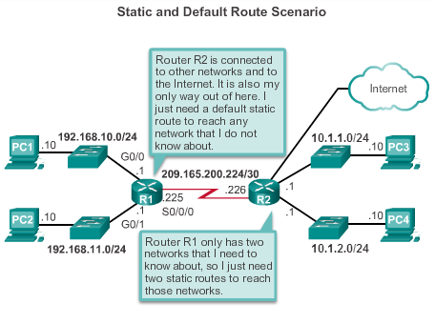
Routing in the Distribution and Core Layers Static Routing
Notes:
5.1.1.2 Static Routing

Slide 7
Routing in the Distribution and Core Layers Static Routing
A network administrator manually configures a static route to reach a specific network.
A static route includes the network address and subnet mask of the remote network, along with the IP address of the next-hop router or exit interface.
Unlike a dynamic routing protocol, static routes are not automatically updated and must be manually reconfigured any time the network topology changes.
A static route does not change until the administrator manually reconfigures it.

Slide 8
Static Routing
Static routing has three primary uses:
Providing ease of routing table maintenance in smaller networks that are not expected to grow significantly.
Routing to and from stub networks. A stub network is a network accessed by a single route, and the router has only one neighbor.
Using a single default route to represent a path to any network that does not have a more specific match with another route in the routing table. Default routes are used to send traffic to any destination beyond the next upstream router.

Slide 9
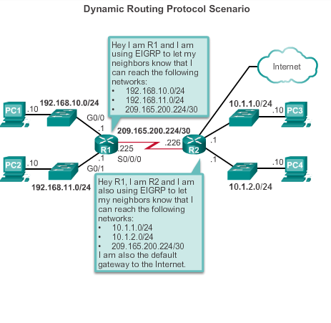
Routing in the Distribution and Core Layers Dynamic Routing Protocols
Notes:
5.1.1.3 Dynamic Routing Protocols

Slide 10
Routing in the Distribution and Core Layers Dynamic Routing Protocols
Dynamic routing protocols are used by routers to share information about the reachability and status of remote networks.
Routers receiving the update automatically add this information to their own routing tables.
The routing protocols then determine the best path, or route, to each network.
A primary benefit of dynamic routing protocols is that routers exchange routing information when there is a topology change.
Two most common dynamic routing protocols are EIGRP and OSPF.

Slide 11
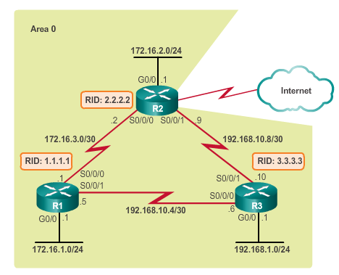
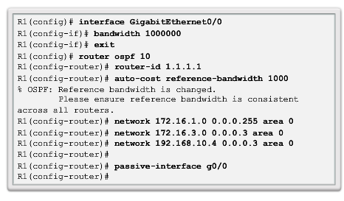
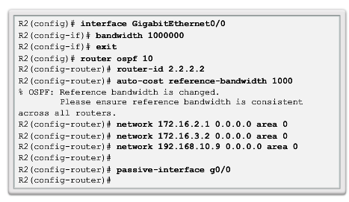
Routing in the Distribution and Core Layers Configuring Single-Area OSPF
Notes:
5.1.1.5 Configuring Single-Area OSPF

Slide 12
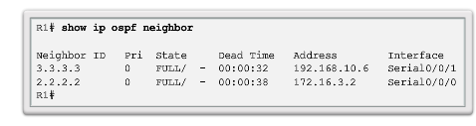
Routing in the Distribution and Core Layers Verifying Single-Area OSPF
Command to verify that the router has formed an adjacency with its neighboring routers. If the router ID of the neighboring router is not displayed, or if it does not show as being in a state of FULL, the two routers have not formed an OSPF adjacency.
Notes:
5.1.1.6 Verifying Single-Area OSPF

Slide 13
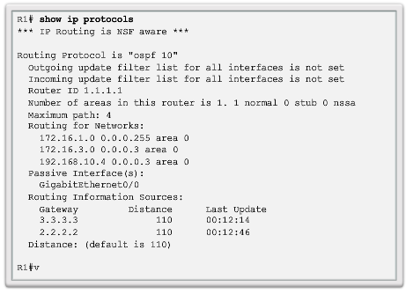
Routing in the Distribution and Core Layers Verifying Single-Area OSPF
Command to verify vital OSPF configuration information, which includes the OSPF process ID, the router ID, networks the router is advertising, the neighbors the router is receiving updates from, and the default administrative distance, which is 110 for OSPF.

Slide 14
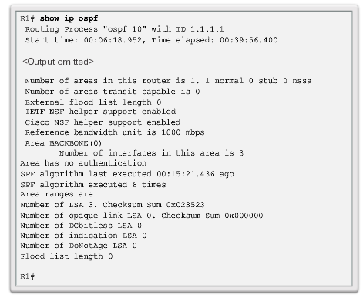
Routing in the Distribution and Core Layers Verifying Single-Area OSPF (cont.)
Command to display the OSPF process ID and router ID as well as the OSPF SPF and OSPF area information.
Notes:
5.1.1.6 Verifying Single-Area OSPF

Slide 15
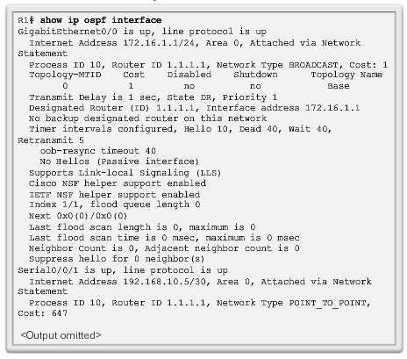
Routing in the Distribution and Core Layers Verifying Single-Area OSPF (cont.)
Command provides a detailed list for every OSPF-enabled interface and is very useful to determine whether the network statements were correctly composed.
Notes:
5.1.1.6 Verifying Single-Area OSPF

Slide 16
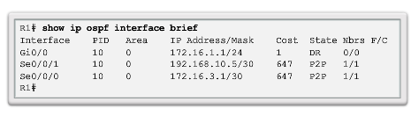
Routing in the Distribution and Core Layers Verifying Single-Area OSPF (cont.)
Command to display a summary and status of OSPF-enabled interfaces.

Slide 17
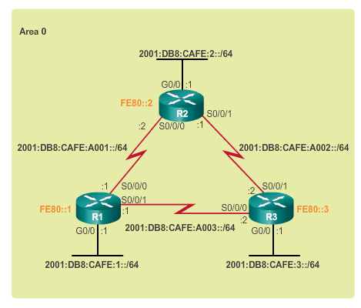
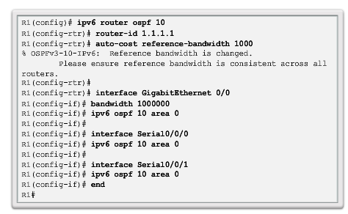
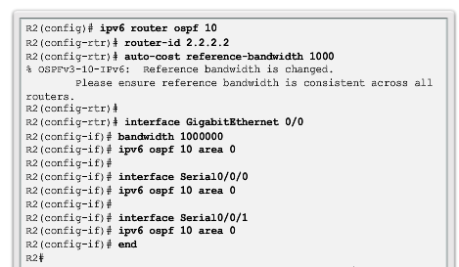
Routing in the Distribution and Core Layers Configuring Single-Area OSPFv3
Notes:
5.1.1.7 Configuring Single-Area OSPFv3

Slide 18
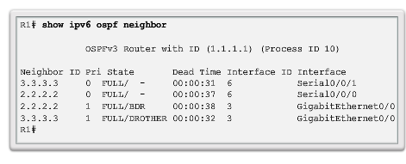
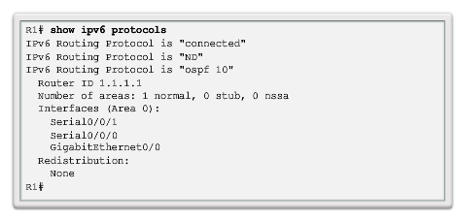
Routing in the Distribution and Core Layers Verifying Single-Area OSPFv3
Notes:
5.1.1.8 Verifying Single-Area OSPFv3

Slide 19
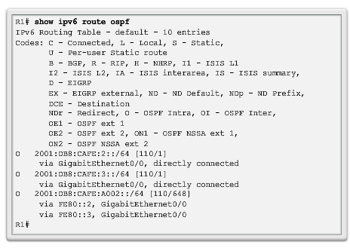
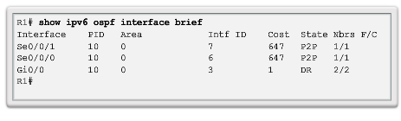
Routing in the Distribution and Core Layers Verifying Single-Area OSPFv3 (cont.)
Notes:
5.1.1.8 Verifying Single-Area OSPFv3

Slide 20
OSPF in Multiaccess Networks OSPF Network Types
OSPF defines 5 network types;
Point-to-point – Two routers interconnected over a common link. Often the configuration in WAN links.
Broadcast Multiaccess – Multiple routers interconnected over an Ethernet network.
Non-broadcast Multiaccess (NBMA) – Multiple routers interconnected in a network that does not allow broadcasts, such as Frame Relay.
Point-to-multipoint – Multiple routers interconnected in a hub-and-spoke topology over an NBMA network.
Virtual links – Special OSPF network used to interconnect distant OSPF areas to the backbone area.
Notes:
5.1.2.1 OSPF Network Types

Slide 21
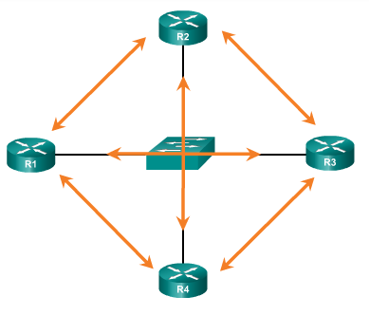
OSPF in Multiaccess Networks Challenges in Multiaccess Networks
Multiaccess networks can create two challenges for OSPF:
Creation of multiple adjacencies – creating adjacencies with multiple routers would lead to an excessive number of LSAs being exchanged.
Extensive flooding of LSAs – Link-state routers flood the network when OSPF is initialized or when there is a change. This flooding can be excessive.
Formula used to calculate the number of required adjacencies n(n-1)/2
A topology of 4 routers would result in 4(4-1)/2 = 6
Notes:
5.1.2.2 Challenges in Multiaccess Networks

Slide 22
OSPF in Multiaccess Networks OSPF Designated Router
The designated router (DR) is the solution to managing adjacencies and flooding of LSAs on a multiaccess network. OSPF elects a DR to be the collection and distribution point for LSAs sent and received.
The backup designated router (BDR) is elected in case the DR fails.
All other non-DR and non-BDR routers become DROTHERs. DROTHERs only form adjacencies with the DR and BDR.
DROTHERs only send their LSAs to the DR and BDR using the multicast address 224.0.0.6.
DR uses the multicast address 224.0.0.5 to send LSAs to all other routers. DR only router flooding LSAs.
DR/BDR Elections only necessary on multiaccess networks not in point-to-point networks.
Notes:
5.1.2.3 OSPF Designated Router

Slide 23
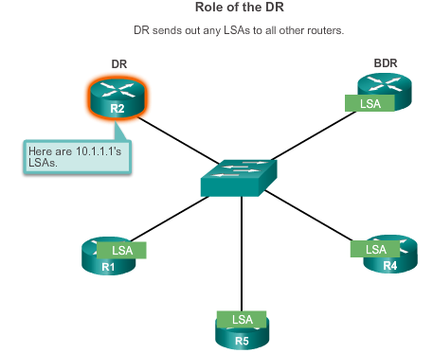
OSPF in Multiaccess Networks OSPF Designated Router (cont.)
Notes:
5.1.2.3 OSPF Designated Router

Slide 24
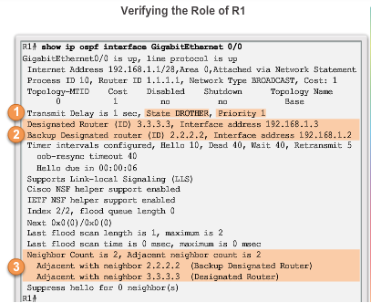
OSPF in Multiaccess Networks Verifying DR/BDR Roles
Notes:
5.1.2.4 Verifying DR/BDR Roles

Slide 25
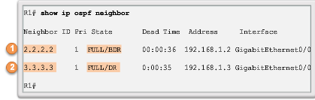
OSPF in Multiaccess Networks Verifying DR/BDR Adjacencies
State of neighbors in multiaccess networks can be:
FULL/DROTHER – This is a DR or BDR router that is fully adjacent with a non-DR or BDR router.
FULL/DR – The router is fully adjacent with the indicated DR neighbor.
FULL/BDR – The router is fully adjacent with the indicated BDR neighbor.
2-WAY/DROTHER – The non-DR or BDR router has a neighbor adjacency with another non-DR or BDR router.
Notes:
5.1.2.5 Verifying DR/BDR Adjacencies

Slide 26
OSPF in Multiaccess Networks Verifying DR/BDR Adjacencies
The normal state for an OSPF router is usually FULL.
If a router is stuck in another state, it is an indication that there are problems in forming adjacencies.
The only exception to this is the 2-WAY state, which is normal in a multiaccess broadcast network.

Slide 27
OSPF in Multiaccess Networks Default DR/BDR Election Process
The router with the highest interface priority is elected as the DR.
The router with the second highest interface priority is elected as the BDR.
Priority can be configured between 0-255. (Priority of 0 - router cannot become the DR. 0
If interface priorities are equal, then the router with highest router ID is elected DR and second highest the BDR
Three ways to determine router ID:
Router ID can be manually configured.
If not configured, the ID determined by the highest loopback IP address.
If no loopbacks, the ID is determined by the highest active IPv4 address.
In an IPv6 network, the router ID must be configured manually.
Notes:
5.1.2.6 Default DR/BDR Election Process

Slide 28
OSPF in Multiaccess Networks DR/BDR Election Process
DR remains the DR until one of the following occurs:
The DR fails.
The OSPF process on the DR fails or is stopped.
The multiaccess interface on the DR fails or is shutdown.
If the DR fails, the BDR is automatically promoted to DR.
There is then a new BDR election and the DROTHER with the higher priority or router ID is elected as the new BDR.
Notes:
5.1.2.7 DR/BDR Election Process

Slide 29
OSPF in Multiaccess Networks DR/BDR Election Process
The DR becomes the focal point for the collection and distribution of LSAs; therefore, this router must have sufficient CPU and memory capacity to handle the workload. It is possible to influence the DR/BDR election process through configurations.
If the interface priorities are equal on all routers, the router with the highest router ID is elected the DR. It is possible to configure the router ID to manipulate the DR/BDR election. However, this process only works if there is a stringent plan for setting the router ID on all routers. In large networks, this can be cumbersome.

Slide 30
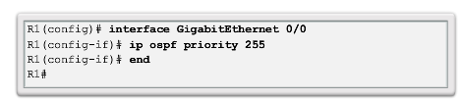
OSPF in Multiaccess Networks The OSPF Priority
Instead of setting the router ID on all routers, it is better to control the election by setting interface priorities.
To change the priority, use one of the following commands:
ip ospf priority value (OSPFv2 interface command)
ipv6 ospf priority value (OSPFv3 interface command)
To begin another OSPF election, use one of the following methods:
Shutdown the router interfaces and then re-enable them starting with the DR, then the BDR, and then all other routers.
Reset the OSPF process using the clear ip ospf process privileged EXEC mode command on all routers.
Notes:
5.1.2.8 The OSPF Priority
5.1.2.9 Changing the OSPF priority

Slide 31
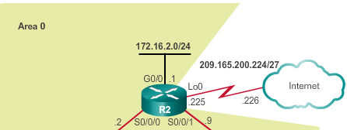
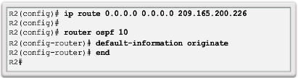
Default Route Propagation Propagating a Default Static Route in OSPFv2
With OSPF, the router connected to the Internet is used to propagate a default route to other routers in the OSPF routing domain. It is often called the edge, entrance or gateway router. In an OSPF network, it may also be call the autonomous system boundary router (ASBR).
Notes:
5.1.3.1 Propagating a Default Static Route in OSPFv2

Slide 32
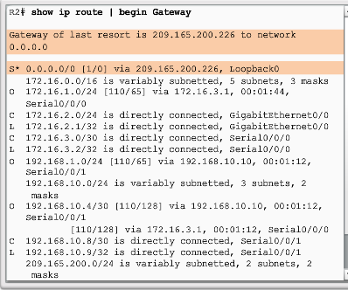
Default Route Propagation Verifying the Propagated Default Route
Notes:
5.1.3.2 Verifying the Propagated Default Route

Slide 33
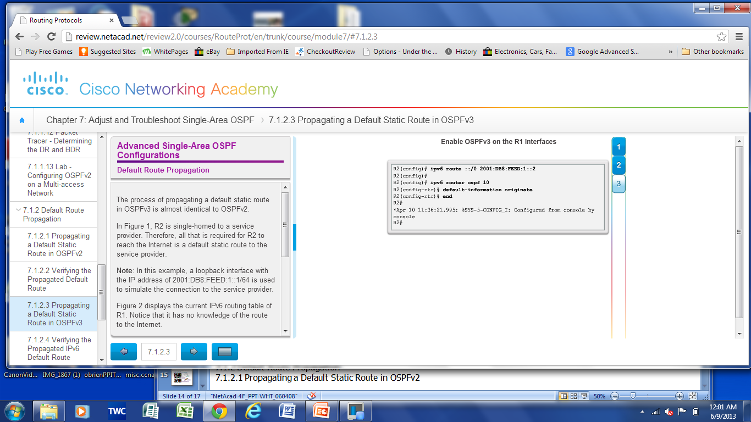
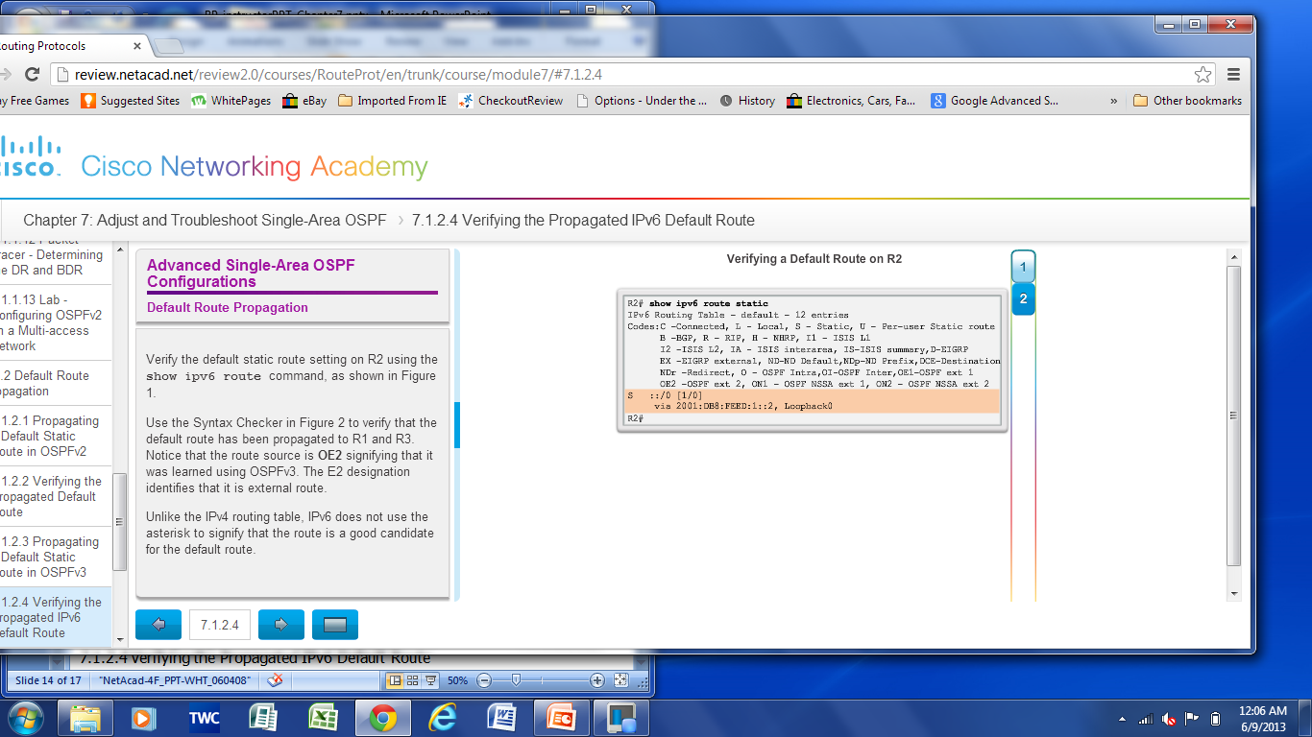
Default Route Propagation Propagating a Default Static Route in OSPFv3
Enabling OSPFv3 on the R1 Interfaces
Verifying the propagated IPv6 default Route
Notes:
5.1.3.3 Propagating a Default Static Route in OSPFv3
5.1.3.4 Verifying the Propagated IPv6 Default Route

Slide 34
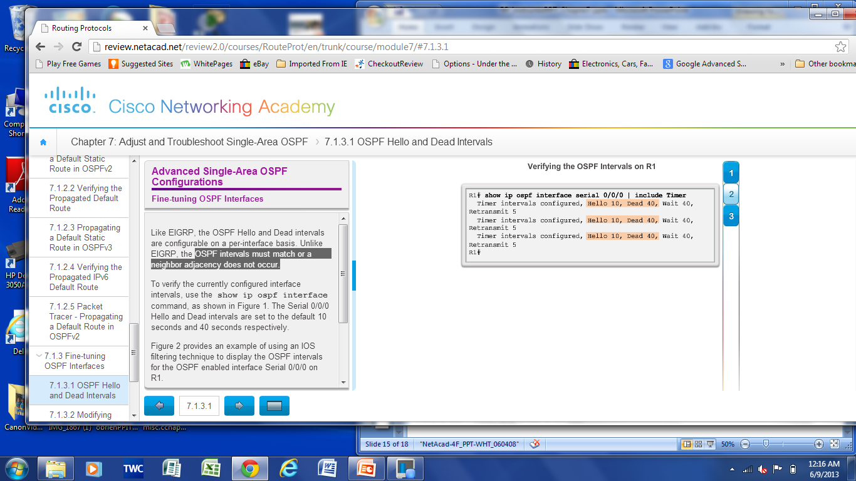
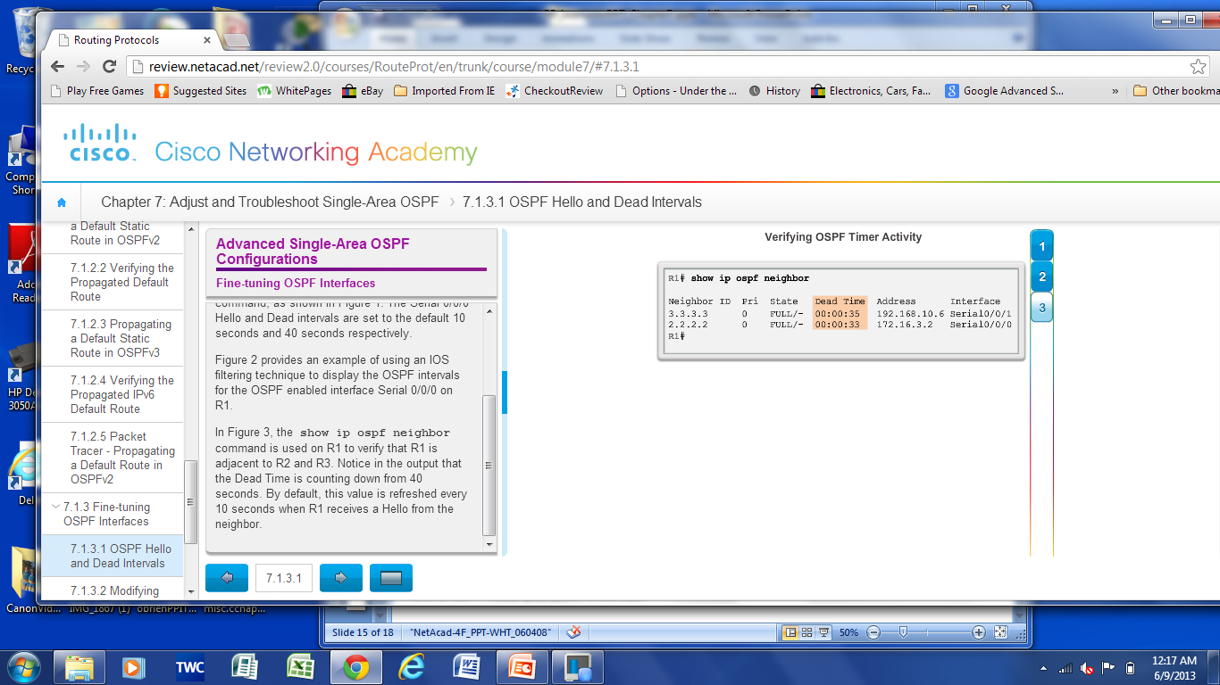
Fine-tuning OSPF Interfaces OSPF Hello and Dead Intervals
The OSPF Hello and Dead intervals are configurable on a per-interface basis. OSPF Hello and Dead intervals must match, or a neighbor adjacency will not occur.
Notes:
5.1.4.1 OSPF Hello and Dead Intervals

Slide 35
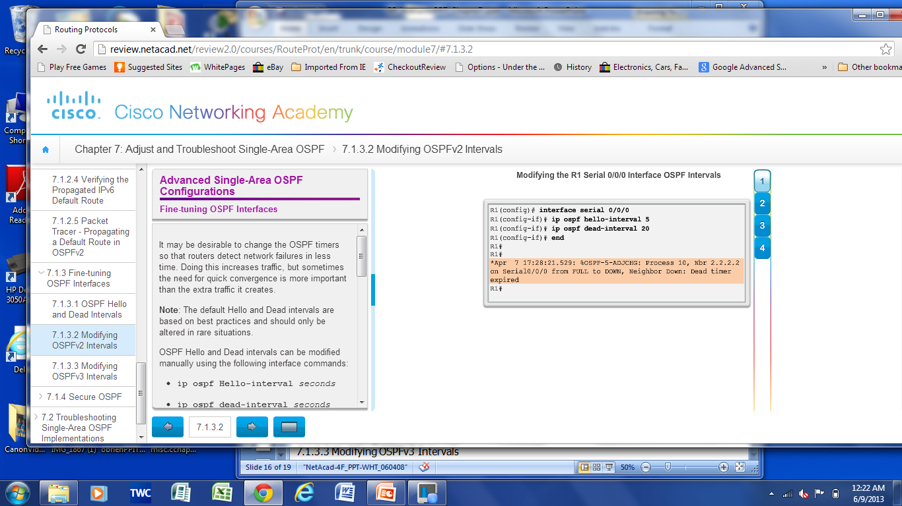
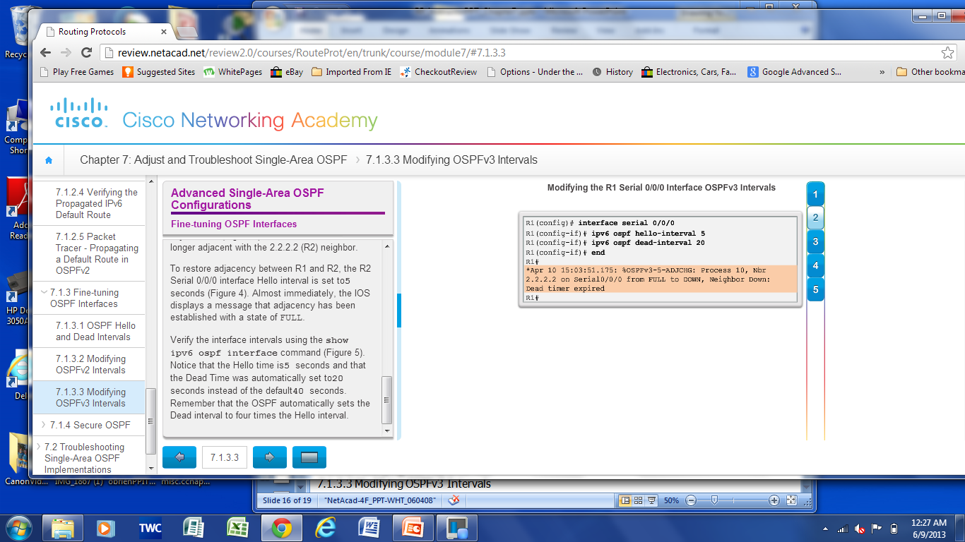
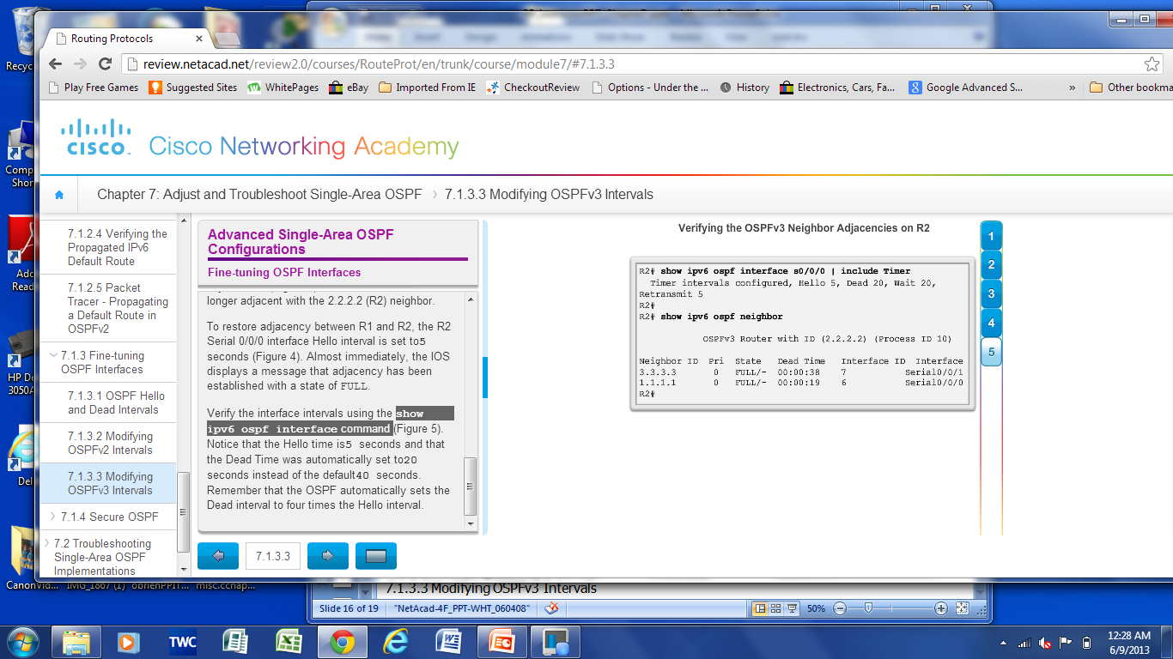
Fine-tuning OSPF Interfaces Modifying OSPF Intervals
Modifying OSPFv2 Intervals
Modifying OSPFv3 Intervals
Verifying the OSPFv3 interface intervals
Notes:
5.1.4.2 Modifying OSPFv2 Intervals
5.1.4.3 Modifying OSPFv3 Intervals

Slide 36
Secure OSPF Secure Routing Updates
The role of routers in a network is so crucial that they are often the targets of network attacks.
In general, routing systems can be attacked by disrupting the routing peers or by falsifying the information carried within the routing protocol. Falsified routing information may generally be used to cause systems to misinform (lie to) each other, cause a denial-of-service (DoS) attack, or cause traffic to follow a path it would not normally follow.
The consequences of falsifying routing information are:
Redirecting traffic to create routing loops
Redirecting traffic so it can be monitored on an insecure link
Redirecting traffic to discard it

Slide 37
Secure OSPF Secure Routing Updates
When neighbor authentication has been configured on a router, the router authenticates the source of each routing update packet that it receives.
An authenticating key that is known to both the sending and the receiving route is exchanged.
OSPF supports three types of authentication:
Null – no authentication.
Simple password authentication – the password in the update is sent in plaintext over the network (outdated method).
MD5 authentication – Most secure and recommended method of authentication. Password is calculated using the MD5 algorithm.
Notes:
5.1.5.1 Routers are Targets
5.1.5.2 Secure Routing Updates

Slide 38
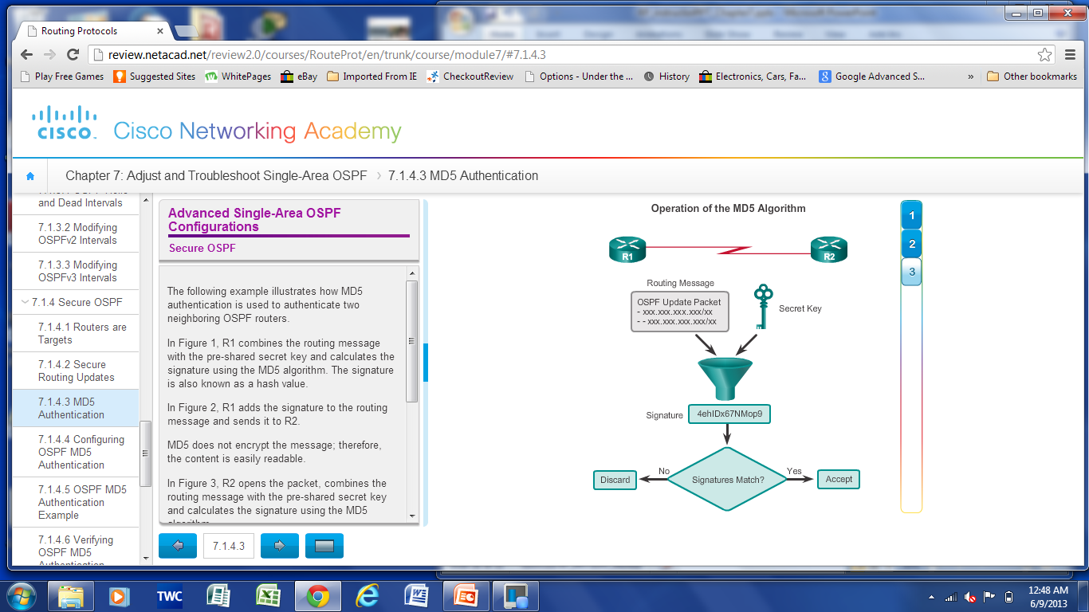
Secure OSPF MD5 Authentication
R1 combines the routing message with the pre-shared secret key and calculates the signature using the MD5 algorithm. The signature is also known as a hash value.
R2 opens the packet, combines the routing message with the pre-shared secret key and calculates the signature using the MD5 algorithm.
If the signatures match, then R2 accepts the routing update.
If the signatures do not match, then R2 discards the update.
Notes:
5.1.5.3 MD5 Authentication

Slide 39
Secure OSPF Configuring OSPF MD5 Authentication
MD5 authentication can be enabled globally for all interfaces or on a per-interface basis.
To enable OSPF MD5 authentication globally, configure:
ip ospf message-digest-key key md5 password (interface configuration command)
area area-id authentication message-digest (router configuration command)
To enable MD5 authentication on a per-interface basis, configure:
ip ospf message-digest-key key md5 password (interface configuration command)
ip ospf authentication message-digest (interface configuration command)
Notes:
5.1.5.4 Configuring OSPF MD5 Authentication

Slide 40
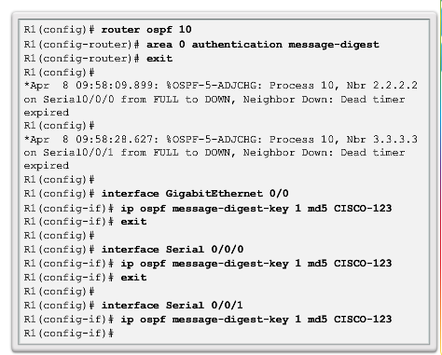
Secure OSPF OSPF MD5 Authentication Example
continued
Notes:
5.1.5.5 OSPF MD5 Authentication Example

Slide 41
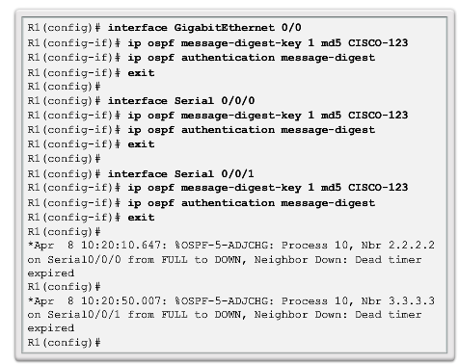
Secure OSPF OSPF MD5 Authentication Example (cont.)
Notes:
5.1.5.5 OSPF MD5 Authentication Example

Slide 42
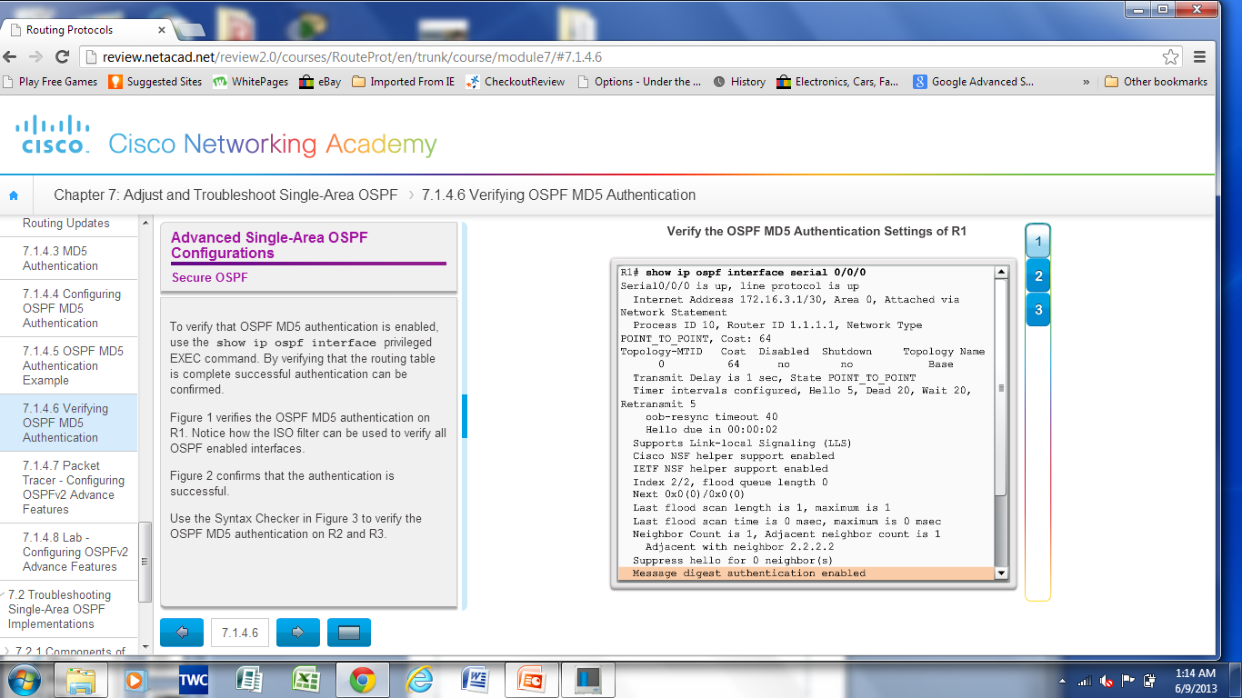
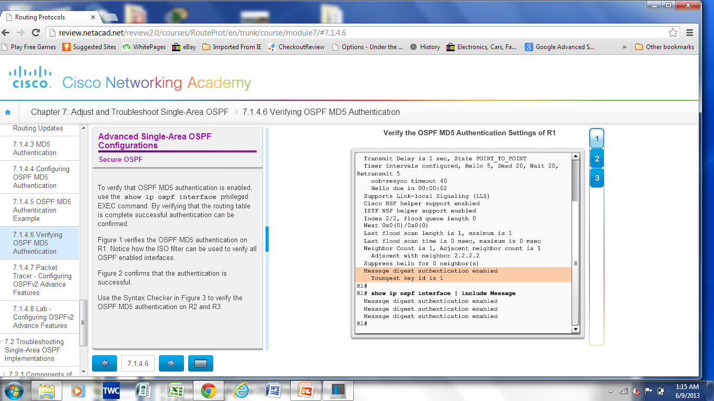
Secure OSPF Verifying OSPF MD5 Authentication
Notes:
5.1.5.6 Verifying OSPF MD5 Authentication

Slide 43
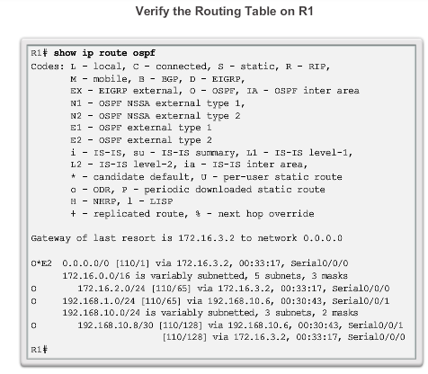
Secure OSPF Verifying OSPF MD5 Authentication (cont.)
Notes:
5.1.5.6 Verifying OSPF MD5 Authentication

Slide 44
5.2 Troubleshooting Single-Area OSPF Implementations
Notes:
5.2 Troubleshooting Single-Area OSPF Implementations

Slide 45
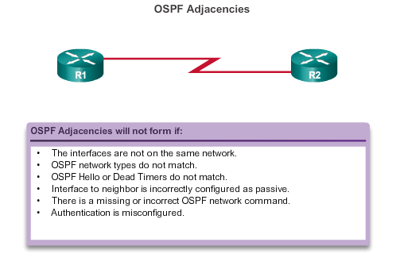
Components of Troubleshooting Single-Area OSPF Forming OSPF Adjacencies
Notes:
5.2.1.1 Overview

Slide 46
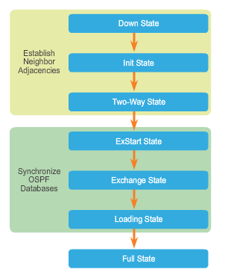
Components of Troubleshooting Single-Area OSPF Transitioning via OSPF States
To troubleshoot OSPF, it is important to understand how OSPF routers traverse different OSPF states when adjacencies are being established.
The router should not remain in any states other than FULL or 2Way for extended periods of time.
Notes:
5.2.1.2 OSPF States

Slide 47
Components of Troubleshooting Single-Area OSPF OSPF Troubleshooting Commands
show ip protocols – Verifies vital OSPF configuration information.
show ip ospf neighbor – Verifies that the router has formed an adjacency with its neighboring routers.
show ip ospf interface – Displays the OSPF parameters configured on an interface, such as the OSPF process ID.
show ip ospf – Examines the OSPF process ID and router ID.
show ip route ospf – Displays only the OSPF learned routes in the routing table.
clear ip ospf [process-id] process – Resets the OSPFv2 neighbor adjacencies.
Notes:
5.2.1.3 OSPF Troubleshooting Commands

Slide 48
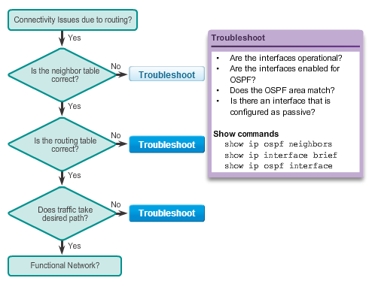
Components of Troubleshooting Single-Area OSPF Components of Troubleshooting OSPF
Notes:
5.2.1.4 Components of Troubleshooting OSPF

Slide 49
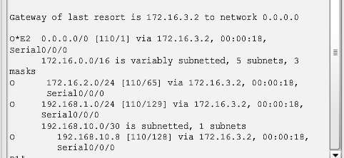
Troubleshoot Single-Area OSPFv2 Routing Issues Troubleshooting Neighbor Issues
Verify active OSPF interfaces using the show ip ospf interface command.
Verify the OSPF settings using the show ip protocols command.
Disable the interface as passive using the no passive-interface command.
Verify routes using the show ip route command.
Notes:
5.2.2.1 Troubleshooting Neighbor Issues

Slide 50
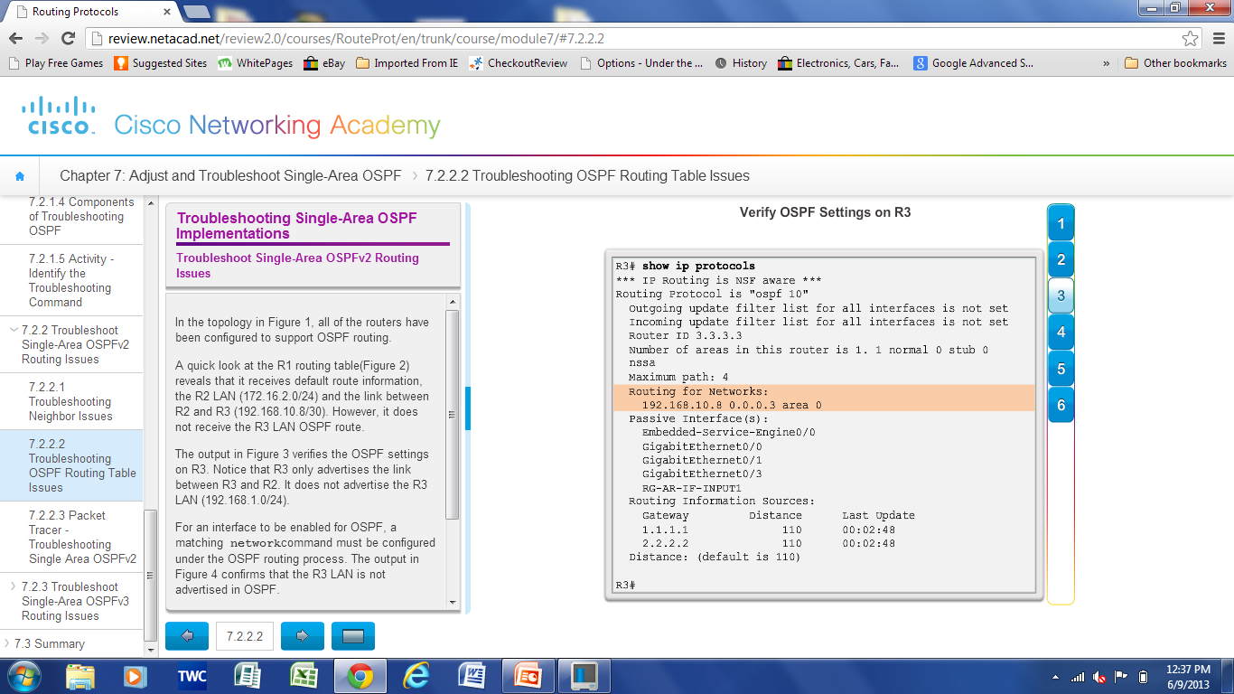
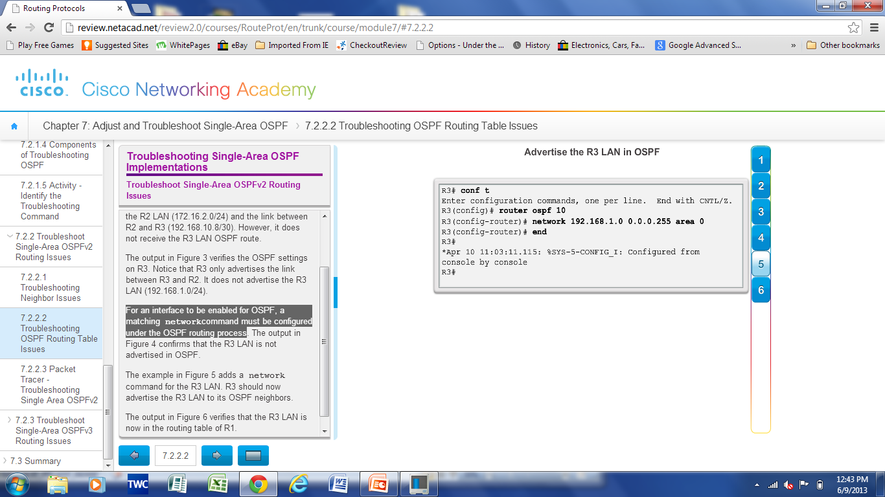
Troubleshoot Single-Area OSPFv2 Routing Issues Troubleshooting OSPF Routing Table Issues
The show ip protocols command verifies networks that are advertised in OSPF.
For an interface to be enabled for OSPF, a matching network command must be configured under the OSPF routing process.
Use the show ip route command to verify routes in a routing table.
Use the show ip protocols command to verify that a route is being advertised.
Notes:
5.2.2.2 Troubleshooting OSPF Routing Table Issues

Slide 51
Troubleshoot Single-Area OSPFv3 Routing Issues OSPFv3 Troubleshooting Commands
show ipv6 protocols – Verifies vital OSPFv3 configuration information.
show ipv6 ospf neighbor – Verifies that the router has formed an adjacency with its neighboring routers.
show ipv6 ospf interface – Displays the OSPFv3 parameters configured on an interface.
show ipv6 ospf – Examines the OSPFv3 process ID and router ID.
show ipv6 route ospf – Displays only the OSPFv3 learned routes in the routing table.
clear ipv6 ospf [process-id] process – Resets the OSPFv3 neighbor adjacencies.
Notes:
5.2.3.2 Troubleshooting OSPFv3

Slide 52
Chapter 5: Summary
OSPF defines five network types: point-to-point, broadcast multiaccess, NBMA, point-to-multipoint, and virtual links.
The DR and BDR are elected to overcome challenges of flooding in an OSPF network.
The routers in the network elect the router with the highest interface priority as DR. The router with the second highest interface priority is elected as the BDR.
If all priorities are equal, the router with the highest ID is elected DR and the second highest ID becomes the BDR.
To propagate a default route in OSPF, the ASBR must be configured with a default static route and the default-information originate command.
Verify routes with the show ip route or show ipv6 route command.
Notes:
Chapter 5 Summary

Slide 53
Chapter 5: Summary (cont.)
For OSPF to make a correct path determination, it may be necessary to adjust the default interface bandwidth.
To adjust the reference bandwidth, use the auto-cost reference-bandwidth Mbps router configuration mode command.
To adjust the interface bandwidth, use the bandwidth kilobits interface configuration mode command.
The OSPF Hello and Dead intervals must match or a neighbor adjacency does not occur.
OSPF supports three types of authentication: null, simple password authentication, and MD5 authentication.
When troubleshooting OSPF neighbors, be aware that the FULL or 2WAY states are normal.
Notes:
Chapter 5 Summary

Slide 54
Chapter 5: Summary (cont.)
Troubleshooting commands: show ip protocols, show ip ospf neighbor, show ip ospf interface, show ip ospf
Troubleshooting OSPFv3 commands: show ipv6 protocols, show ipv6 ospf neighbor, show ipv6 ospf interface, show ipv6 ospf, show ipv6 route ospf, and clear ipv6 ospf [process-id] process
Notes:
Chapter 5 Summary

Slide 55


